Slide 1
PCL 302
CNS DRUGS – NARCOTIC ANAGELSICS
DR R. ADISA
DEPARTMENT OF CLINICAL PHARMACY AND BIOPHARMACY

Slide 2
Learning outcome
At the end of this lecture, students should be able to provide comprehensive explanation on:
The general principles and scope of activities for narcotic analgesics
Narcotic analgesics and pain management
Narcotics analgesics for different types of pain
Place of narcotic analgesic in WHO analgesic ladder
Narcotic analgesics and safety
Commonly used narcotic analgesics

Slide 3
Introduction and Definitions
Narcotic analgesics are a class of drugs that provide relief from moderate-to-severe acute or chronic pain or cancer pain
Narcotic analgesics are one of the most widely used analgesics for pain relief; however, they have been overused, overprescribed, and misused resulting in many people having a substance misuse disorder involving prescription narcotic analgesics
Narcotic analgesics work by binding to opioid receptors i.e. part of the opioid system that controls pain, pleasurable and addictive behaviours
Narcotic analgesics may also be referred to as opiates, opioid analgesics or narcotics
Opioids are substances that act on opioid receptors to produce morphine-like effects
The three types of opioid receptors are: the mu, the kappa and the delta. Binding to the three receptors will lead to the analgesic effects, but also to some side effects such as sedation, euphoria, respiratory depression, constipation and physical dependence
Opioid receptors are more abundant in the brain and spinal cord but are also located elsewhere in the body such as the stomach and the lungs. The main opioid receptor that narcotic analgesics bind to is the mu receptor

Slide 4
Introduction contd.
Narcotic analgesics differ in their structure, potency, and the way they are absorbed, distributed, metabolized and excreted within the body.
There are three main classes of opioids – those that are structurally like morphine (the phenanthrenes), those that resemble fentanyl (the phenylpiperidines), and those that resemble methadone (the phenylheptylamines).
Different narcotic analgesics have different potencies, based on how strongly they bind to the opioid receptor (for example, fentanyl is 80 to 100 times stronger than morphine.
It means that dosages for one narcotic may be significantly different from another
Although conversion charts exist that indicate what dose of a narcotic compares to the equivalent analgesic dose of morphine.
However, the charts are only at best a guide because other variables, such as an individual’s genetics, also play a part in a person’s response to a narcotic.

Slide 5
If a narcotic analgesic is deemed appropriate, codeine or tramadol should be tried first if the pain is mild-to-moderate.
If the pain is unresponsive to codeine or tramadol analgesics, or for more severe pain, then hydromorphone, morphine, or oxycodone should be considered
Fentanyl and methadone should only be used for severe pain that is unresponsive to other narcotic analgesics
For cancer pain, the World Health Organization (WHO) analgesic ladder forms the basis for the use of analgesic drugs
Breakthrough pain is treated with doses of immediate-release opioids, usually prescribed in addition to modified release formulations
Antiemetics and laxatives should be prescribed for patients taking opioids so as to ameliorate the side effect of emesis and constipation, respectively, that may accompany the opioid use
Most drugs are available in a range of different formulations, but whenever possible, the oral route should be used.

Slide 6
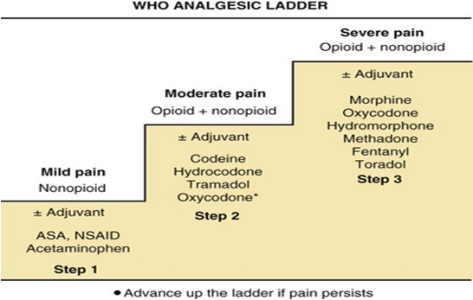

Slide 7
Pain is defined as:
An unpleasant sensory and emotional experience associated with actual or potential tissue damage, or described in terms of suchdamage
Acute pain may be thought of as a physiological process having a biological function, allowing the patient to avoid or minimise injury
Persistent or long-term pain, on the other hand, may be considered more as a disease in its own right than a symptom
Opioids for mild-to-moderate pain
- Opioids for mild-to-moderate pain (‘weak opioids’) are prescribed frequently, either alone or in combination with other analgesics, for a wide variety of painful disorders.
There are three major drugs i.e. codeine, dihydrocodeine and dextropropoxyphene, which are recommended as step 2 of the WHO analgesic ladder for pain that has not responded to non-opioid analgesics.
- Despite this recommendation, there is little data demonstrating that weak opioids are of any benefit in the relief of long-term pain, and it may be more beneficial to use a smaller dose of a more potent opioid.

Slide 8
Codeine
Codeine is the prototypical opioid for moderate pain. It is structurally similar to morphine, and about 10% of the dose is demethylated to form morphine, and the analgesic effects are likely to be due to this active metabolite
It is a powerful cough suppressant as well as being constipating. In combination with NSAIDs, the analgesic effects are usually additive, but the variability in response is considerable.
A genetic polymorphism occurs within the population such that the hepatic microsomal enzyme CYP2D6 that is responsible for the conversion of codeine to morphine does not catalyse this conversion in approximately 8% of the Caucasian population.
The duration of analgesic action is about 3 hours.

Slide 9
Dihydrocodeine
Dihydrocodeine is only available in a few countries and is chemically similar to codeine. It has similar properties to codeine when used at the same dosage and may be slightly more potent
Dextropropoxyphene
Historically, dextropropoxyphene was prescribed in combination with other analgesics such as paracetamol (e.g. co-proxamol).
There are few data on its therapeutic value, and at least one review concluded that analgesic eficacy is less than aspirin and barely more than placebo.
At best, dextropropoxyphene failed to show any superiority over paracetamol

Slide 10
Opioids for severe pain
Morphine
Morphine (‘strong opioid’) is the gold-standard opioid analgesic for severe pain
It is available for administration by a range of administration routes, including oral, rectal and injectable formulations, and has a duration of action of about 4 hours after oral administration.
Morphine is metabolised in the liver, and its most pharmacologically active metabolite is morphine-6-glucuronide, and this should be taken into consideration in patients who have renal failure
A general protocol for morphine use to obtain rapid relief from acute pain is to use intravenous bolus doses of 2–5 mg titrated until pain relief is achieved.
In the initial management of long-term pain, an oral regimen is more appropriate using an immediate-release formulation

Slide 11
Morphine contd.
A usual starting dose is 5–10 mg every 4 hours, and the patient should be advised to take the same dose as often as is necessary for breakthrough pain.
- It may be necessary to double the dose every 24 hours until pain relief is achieved, although a slower dose escalation will often suffice.
After control is achieved, it is usual to change to an oral modified-release formulation, which allows less frequent dosing, either daily or twice daily.
Theoretically, there is no ceiling effect when the dose is increased. However, side effects usually prevent dose escalation;
- daily doses of up to oral morphine 1 or 2 g/day may be required for some cancer patients, but relatively few require more than about 200 mg daily.

Slide 12
Other strong opioids
Opioids such as pethidine and dextromoramide offer little advantage over morphine in that they are generally weaker in action with a relatively short duration of action (2 hours).
Dipipanone is only available in a preparation which contains an antiemetic (cyclizine), and increasing doses lead to sedation and the risk of developing a tardive dyskinesia with long-term use.
Methadone has a long elimination half-life of 15–25 hours, and accumulation occurs in the early stages of use. It has minimal side effects with long-term use, and some patients who experience serious adverse effects with morphine may tolerate methadone.
Oxycodone and hydromorphone are synthetic opioids that have been used for many years in North America and more recently in Europe.
- They are available in both immediate- and modified-release preparations. Some patients appear to tolerate these semi-synthetic opioids better than morphine, but there is no evidence to suggest which patients achieve better effect with either of these drugs.

Slide 13
Fentanyl is available as a transdermal formulation for long-term use. The patch is designed to release the drug continuously over 3 days.
When starting the drug, alternative analgesic therapy should be continued for at least the first 12 hours until therapeutic levels are achieved, and an immediate-acting opioid should be available for breakthrough pain.
Patches are replaced every 72 hours
Tramadol
Tramadol is a centrally acting analgesic that has opioid agonist activity and also has monoamine reuptake properties similar to many antidepressants. It is not as potent as morphine, and efficacy is limited by side effects, including an unfavourably high risk of drowsiness, nausea and vomiting.
Its monoaminergic activity appears to be valuable in the management of neuropathic pain and hence may be an acceptable alternative to an opioid.

Slide 14
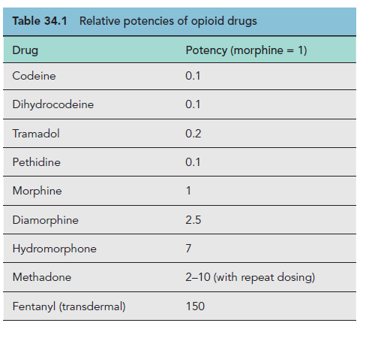
The relative potencies of the commonly used opioids are summarised in
the Table below

Slide 15
Buprenorphine
Buprenorphine is a semi-synthetic, highly lipophilic opioid that is a partial agonist at the μ opioid receptor and an antagonist at both the δ and κ receptors.
It undergoes extensive metabolism when administered orally and to avoid this effect, it is given sublingually
It has high receptor affinity, and as a result has a duration of action of 6 hours.
- A long duration of action and high bioavailability would suggest a role for buprenorphine in the management of long-term pain
Buprenorphine is also available as a transdermal formulation and may be an effective alternative to other strong opioids for long-term non-cancer pain. There is limited evidence of efficacy in osteoarthritis and low back pain.
After sublingual or intravenous administration, the incidence of nausea and vomiting appears to be substantially higher than with morphine; however, respiratory depression and constipation are less frequent.

Slide 16
Pentazocine
Pentazocine, a benzomorphan derivative, is an agonist and at the same time a very weak antagonist at the μ opioid receptor.
Pentazocine became popular in the 1960s, when it was thought it would have little or no abuse potential, but this is now been refuted to be true, although its abuse potential is less than that of the conventional agonists such as morphine
It produces analgesia that is clearly different from morphine and is probably due to agonist actions at the κ receptor.
There are no detailed studies of its use in long-term pain, but its short duration of action (about 3 hours) and the high incidence of psychomimetic side effects make it a totally unsuitable drug for chronic pain.

Slide 17
Tapentadol
Tapentadol is another centrally acting analgesic that combines opioid agonist activity and noradrenaline reuptake inhibition (NRI).
In animal models, the NRI component is a key mechanism and may even predominate over opioid actions in chronic (and especially neuropathic) pain states.
In humans there is a reduced incidence of some of the typical opioid-induced side effects compared with equianalgesic doses of classical opioids.
This supports the hypothesis that tapentadol analgesia is only partially mediated by opioid agonist mechanisms.

Slide 18
Narcotic analgesics and safety
Serious risks are associated with narcotic analgesics including respiratory depression (unusually slow and shallow breathing), opioid-use disorder, and potentially fatal overdose.
Opioid-use disorder is defined as the repeated occurrence of at least two out of 11 specific opioid-associated problems, including using opioids in increased amounts or for longer than intended; continued use despite interference with daily activities; or still using while in hazardous situations.
Severe opioid-use disorder is defined as a cluster of 6 or more problems and it can affect people from all educational and socioeconomic backgrounds.
Narcotic analgesics are potentially addictive and the risk of becoming emotionally and physically dependent on them increases with intake of large amounts, as well as increased length/duration of use.
When obtained on a legal prescription and used for short period of time, such as for less than five days for pain relief, the risk of becoming addicted is relatively low.
The number of fatal overdoses from opioids continues to rise and this has resulted in government officials introducing new legislation to further restrict the prescribing of opioids.
More than 42,000 people died in 2016 because of an opioid overdose; 40% of these deaths involved a prescription narcotic analgesic.

Slide 19
Side effects of narcotic analgesics
Narcotic analgesics have many side effects, although people with cancer or terminal illness taking narcotics for long periods of time may become tolerant to some of these side effects
Drowsiness, sedation, sleepiness, or dizziness is common with most narcotic analgesics. This can affect driving or a person's ability to operate machinery and perform other hazardous tasks. Alcohol may potentiate these effects
Other commonly reported side effects include:
- Constipation, breathing difficulty, itching or a skin rash, loss of appetite, low blood pressure, miosis (constriction of the pupil of the eye), nausea and vomiting, problems with urination, shakiness or a tremor, slow heartbeat.
Withdrawal symptoms may occur when narcotic analgesics is abruptly stopped in individual who has been on it for a long time.
- Symptoms are flu-like, and may include body aches, chills, depression, diarrhea, goose-bumps, headaches, high blood pressure, insomnia, irritability, a runny nose and sweats. Withdrawal symptoms usually last about a week.

Slide 20
Tolerance, dependence and addition
Treatment with opioids in the long-term may cause tolerance to the analgesic effect, although the mechanisms by which this happens remain unclear (Holden et al., 2005)
When this occurs, the dosage may be increased or, alternatively, another opioid can be substituted. When switching to an alternative opioid, equivalence tables should be consulted but should only be considered a guide because there is significant variation for individuals.
It is usual to reduce the equivalent dose by between 25% and 50% to ensure safety.
Addiction is relatively uncommon when opioids are prescribed for pain relief.

Slide 21
THE END

